Slide 1
Sorting
Selection Sort
Lecture#: 10

Slide 2
Objectives Overview
Selection Sort
Concept and Algorithm
Code and Implementation

Slide 3
Selection Sort
It is simple and easy to implement
It is inefficient for large list, usually used to sort lists of no more than 1000 items
In array of n elements, n-1 iterations are required to sort the array

Slide 4
Selection Sort
It process to sort an array in ascending order consists of the following iterations:
In first iteration, the array is scanned from the first to the last element and the element that has the smallest is selected. The value of the selected smallest element is interchanged with the first element of the array
In second iteration, the array is scanned from second to the last element and the element that has smallest value is selected. The value of smallest element is interchanged with the second element of the array
This process is repeated until the entire array is sorted

Slide 5
Selection Sort
Suppose the name of the array is A and it has four elements with the following values:
4 | 19 | 1 | 3
To sort this array in ascending order, n-1, i.e. three iterations will be required.

Slide 6
Selection Sort
Iteration-1
The array is scanned starting from the first to the last element and the element that has the smallest value is selected. The smallest value is 1 at location 3. The address of element that has the smallest value is noted and the selected value is interchanged with the first element i.e.
A[1] and A[3] are swapped
4 | 19 | 1 | 3
1 | 19 | 4 | 3

Slide 7
Selection Sort
Iteration-2
The array is scanned starting from the second to the last element and the element that has the smallest value is selected. The smallest value is 3 at location 4. The address of element that has the smallest value is noted. The selected value is interchanged with the second element i.e.
A[2] and A[4] are swapped
1 | 19 | 4 | 3
1 | 3 | 4 | 19

Slide 8
Selection Sort
Iteration-3
The array is scanned starting from the third to the last element and the element that has the smallest value is selected. The smallest value is 4 at location 3. The address of element that has the smallest value is noted. The selected value is interchanged with the third element i.e.
A[3] and A[3] are swapped
1 | 3 | 4 | 19
1 | 3 | 4 | 19

Slide 9
Sorting an Array of Integers
The picture shows an array of six integers that we want to sort from smallest to largest
[0] [1] [2] [3] [4] [5]
Notes:
The picture shows a graphical representation of an array which we will sort so that the smallest element ends up at the front, and the other elements increase to the largest at the end. The bar graph indicates the values which are in the array before sorting--for example the first element of the array contains the integer 45.

Slide 10
The Selection Sort Algorithm
Start by finding the smallest entry.
[0] [1] [2] [3] [4] [5]
Notes:
The first sorting algorithm that we'll examine is called Selectionsort. It begins by going through the entire array and finding the smallest element. In this example, the smallest element is the number 8 at location [4] of the array.

Slide 11
The Selection Sort Algorithm
Start by finding the smallest entry.
Swap the smallest entry with the first entry.
[0] [1] [2] [3] [4] [5]
Notes:
Once we have found the smallest element, that element is swapped with the first element of the array...

Slide 12
The Selection Sort Algorithm
Start by finding the smallest entry.
Swap the smallest entry with the first entry.
[0] [1] [2] [3] [4] [5]
Notes:
...like this.
The smallest element is now at the front of the array, and we have taken one small step toward producing a sorted array.

Slide 13
The Selection Sort Algorithm
Sorted side
Unsorted side
Part of the array is now sorted.
[0] [1] [2] [3] [4] [5]
Notes:
At this point, we can view the array as being split into two sides: To the left of the dotted line is the "sorted side", and to the right of the dotted line is the "unsorted side". Our goal is to push the dotted line forward, increasing the number of elements in the sorted side, until the entire array is sorted.

Slide 14
The Selection Sort Algorithm
Sorted side
Unsorted side
Find the smallest element in the unsorted side.
[0] [1] [2] [3] [4] [5]
Notes:
Each step of the Selectionsort works by finding the smallest element in the unsorted side. At this point, we would find the number 15 at location [5] in the unsorted side.

Slide 15
The Selection Sort Algorithm
Sorted side
Unsorted side
Find the smallest element in the unsorted side.
Swap with the front of the unsorted side.
[0] [1] [2] [3] [4] [5]
Notes:
This small element is swapped with the number at the front of the unsorted side, as shown here...

Slide 16
The Selection Sort Algorithm
Sorted side
Unsorted side
We have increased the size of the sorted side by one element.
[0] [1] [2] [3] [4] [5]
Notes:
...and the effect is to increase the size of the sorted side by one element.
As you can see, the sorted side always contains the smallest numbers, and those numbers are sorted from small to large. The unsorted side contains the rest of the numbers, and those numbers are in no particular order.

Slide 17
The Selection Sort Algorithm
Sorted side
Unsorted side
Smallest
from
unsorted
The process continues...
[0] [1] [2] [3] [4] [5]
Notes:
Again, we find the smallest entry in the unsorted side...

Slide 18
The Selection Sort Algorithm
Sorted side
Unsorted side
The process continues...
Swap
with
front
[0] [1] [2] [3] [4] [5]
Notes:
...and swap this element with the front of the unsorted side.

Slide 19
The Selection Sort Algorithm
Sorted side
is bigger
Sorted side
Unsorted side
The process continues...
[0] [1] [2] [3] [4] [5]
Notes:
The sorted side now contains the three smallest elements of the array.

Slide 20
The Selection Sort Algorithm
The process keeps adding one more number to the sorted side.
The sorted side has the smallest numbers, arranged from small to large.
Sorted side
Unsorted side
[0] [1] [2] [3] [4] [5]
Notes:
Here is the array after increasing the sorted side to four elements.

Slide 21
The Selection Sort Algorithm
We can stop when the unsorted side has just one number, since that number must be the largest number.
Sorted side
Unsorted side
[0] [1] [2] [3] [4] [5]
Notes:
And now the sorted side has five elements.
In fact, once the unsorted side is down to a single element, the sort is completed. At this point the 5 smallest elements are in the sorted side, and so the the one largest element is left in the unsorted side.
We are done...

Slide 22
The Selection Sort Algorithm
The array is now sorted.
We repeatedly selected the smallest element, and moved this element to the front of the unsorted side.
[0] [1] [2] [3] [4] [5]
Notes:
...The array is sorted.
The basic algorithm is easy to state and also easy to program.

Slide 23
Selection Sort – Pseudocode
Input: An array A[1..n] of n elements.
Output: A[1..n] sorted in descending order
1. for i ← 1 to n - 1
2. min ← i
3. for j ← i + 1 to n {Find the i th smallest element.}
4. if A[j] < A[min] then
5. min ← j
6. end for
7. if min ≠ i then interchange A[i] and A[min]
8. end for

Slide 24
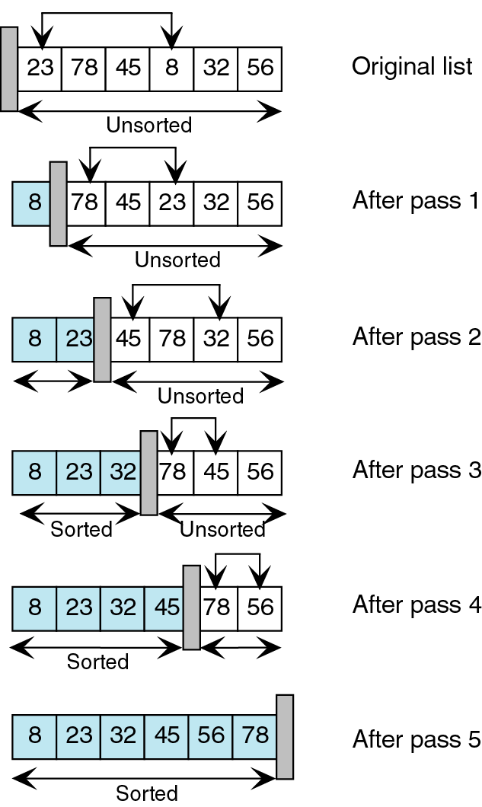
Selection Sort - Step through
This process continues until the list is fully sorted.
We start with an unsorted list. We search this list for the smallest element.
We then exchange the smallest element (8) with the first element in the
unsorted list (23) and move the conceptual wall.
Again, we search the unsorted list for the smallest element.
We then exchange the smallest element (23) with the first element in the unsorted list (78) and move the conceptual wall.

Slide 25
Algorithm – Selection Sort
SelectionSort()
Algorithm to sort an array A consisting of N elements in ascending order
Start
Set U = 1
Repeat step 4 to 11 While (U<N)
Set Temp = A[U]
Set Loc = U
Set I = U + 1
Repeat Step 8 to 9 While (I<=N)

Slide 26
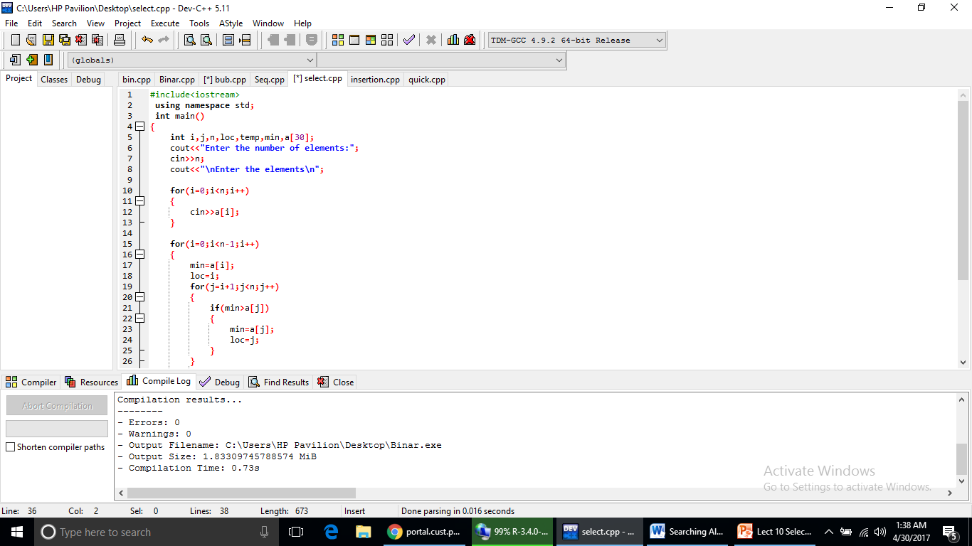
Program

Slide 27
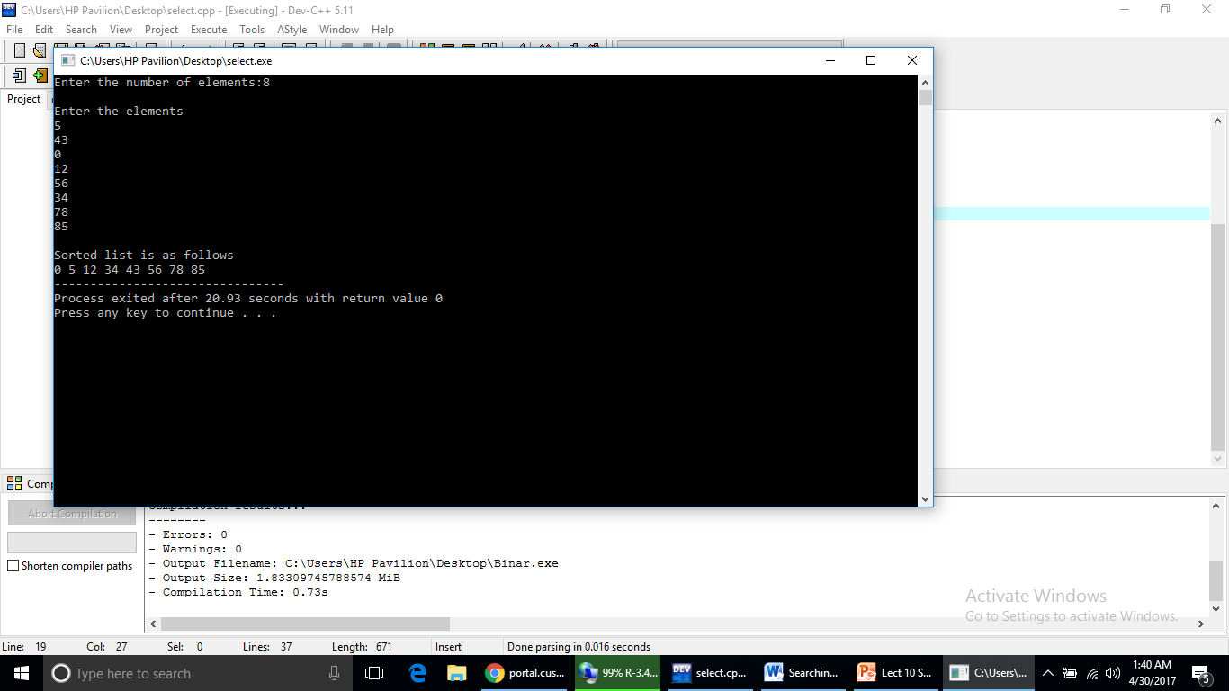
Output
temp=a[i];
a[i]=a[loc];
a[loc]=temp; }
cout<<"\nSorted list is as follows\n";
for(i=0;i<n;i++) {
cout<<a[i]<<" "; }
return 0; }

